Slide 1
Make Education Easy
Presented By:
Animesh Samanta
CSE, 4th Year
Roll: 24400120001
Akash Chowdhury
CSE, 4th Year
Roll:24400120022
Dip Das
IT, 4th Year
Roll:24400220003
Mentor: Mrs. Moumita Chakraborty

Slide 2

Objective Of This Project
Seamless Student-Tutor Interaction
Enabling Offline Learning Experiences
Enhanced Tutor-Student Connectivity
Bridging the Digital-Offline Divide
Empowering Tutors and Students
Monitoring and Feedback Mechanism

Slide 3
Domain
Education
Online Platform
Traditional Education Enhancement
Technology and Innovation
Community Impact

Slide 4
Software and Technology Used
Front End Language: HTML, CSS, and JavaScript
Backend Language: Python
Framework: Flask
Database: SQLite3
Establishing Database Connection: SQL database engine
Software Used:
Vs code (For developing Code)

Slide 5
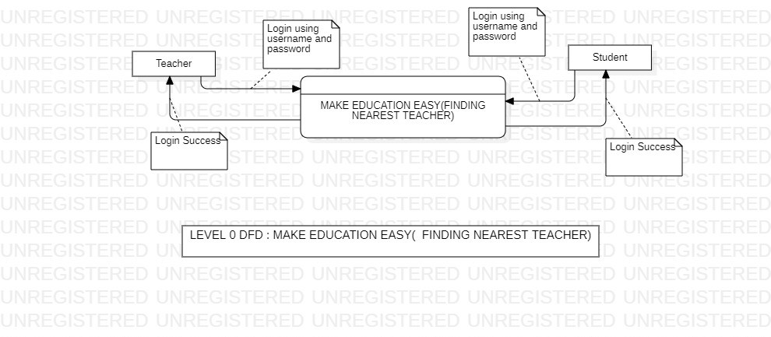
Data Flow Diagram
Level 0 DFD (Make Education Easy)

Slide 6
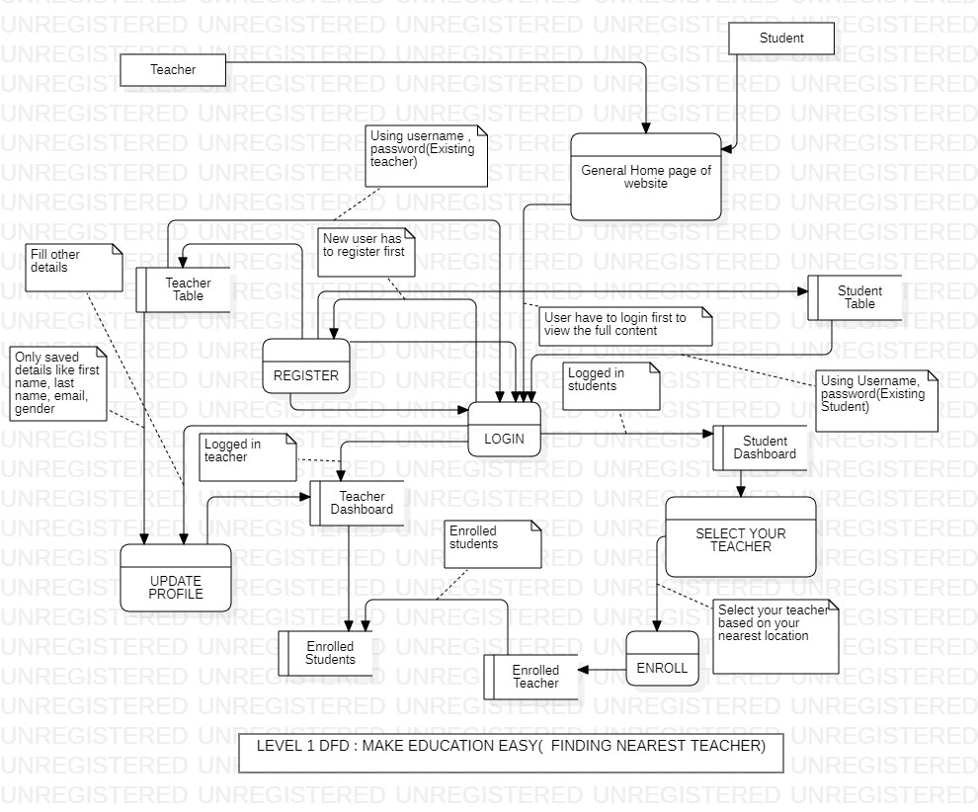
Data Flow Diagram

Slide 7
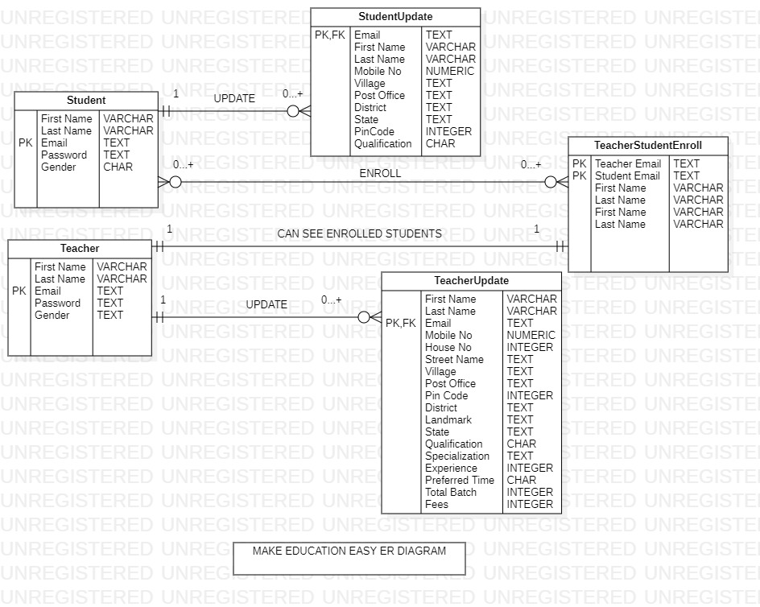
ER Diagram

Slide 8
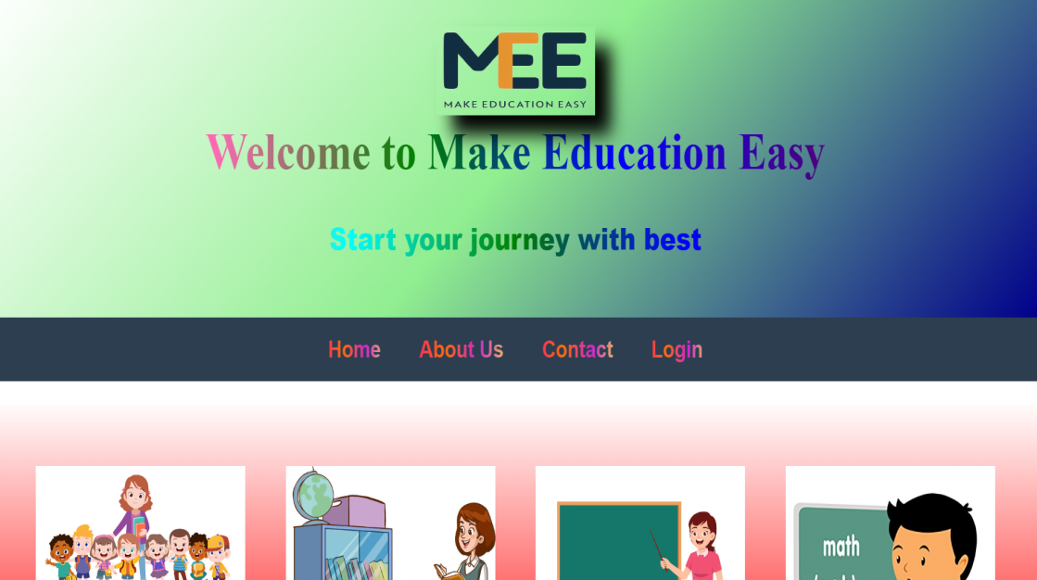
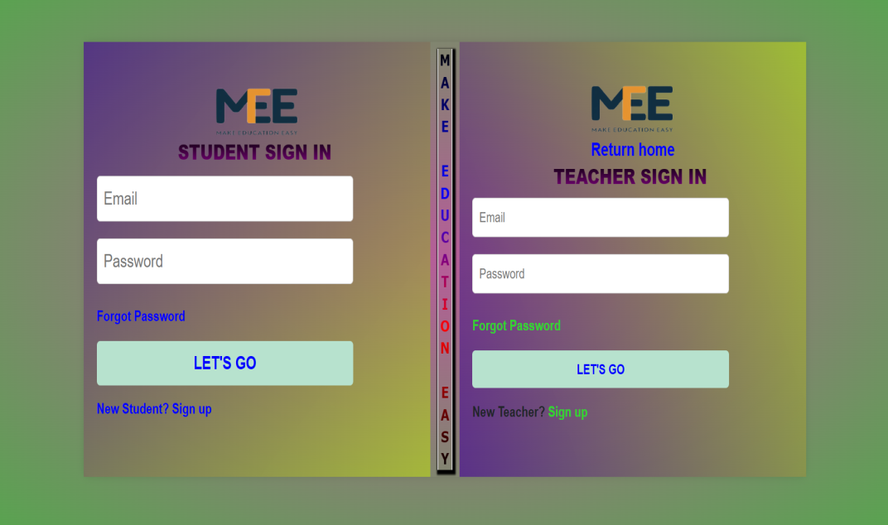
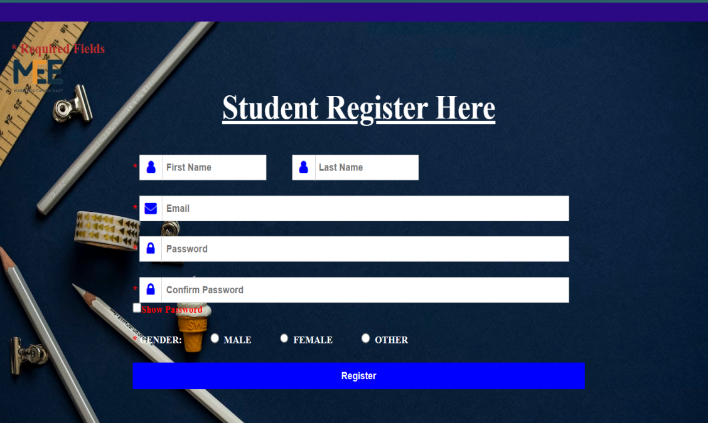
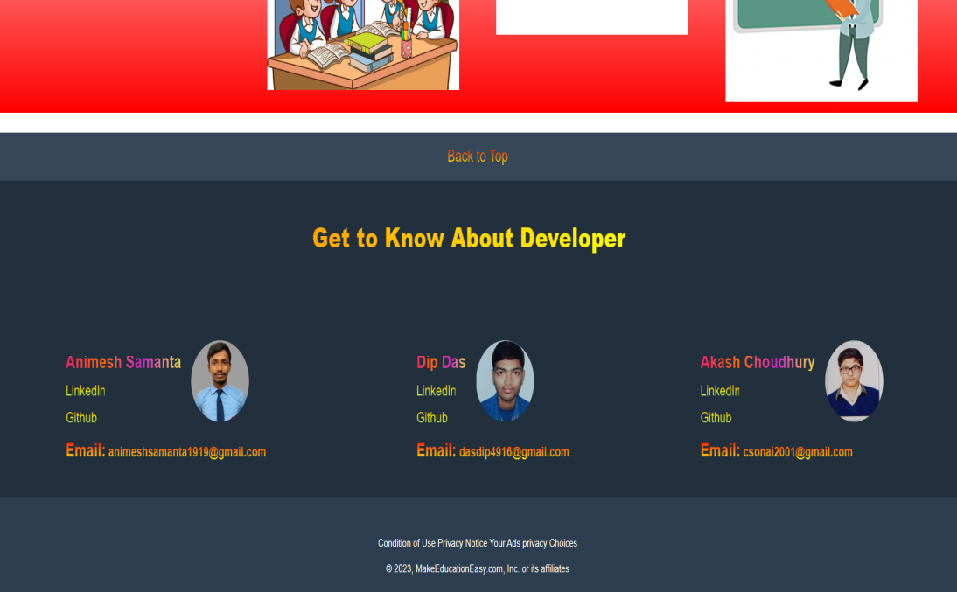
User Interface Page
Home page
Login page
Registration page
Developer page

Slide 9
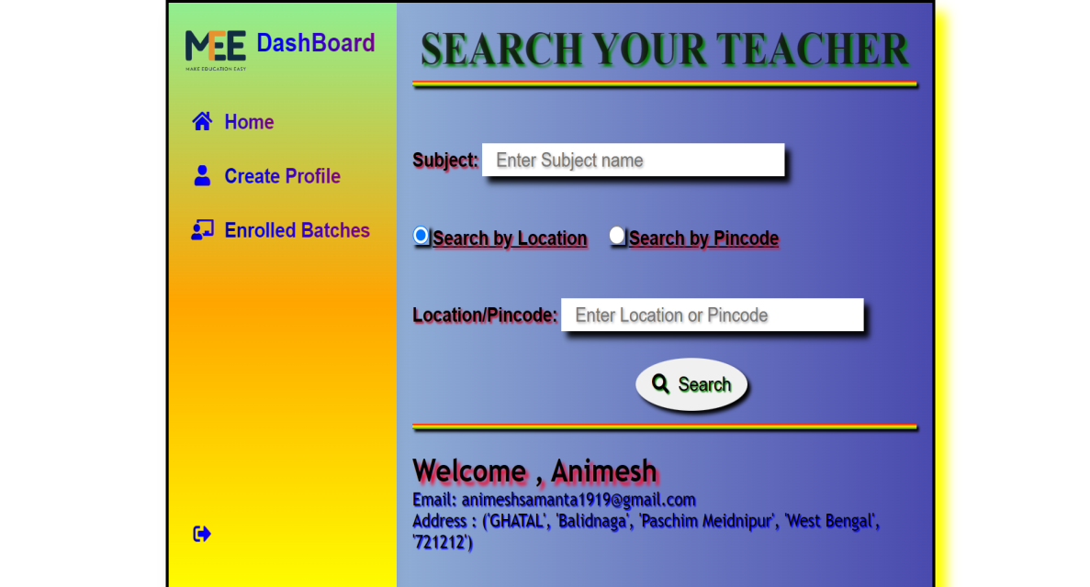
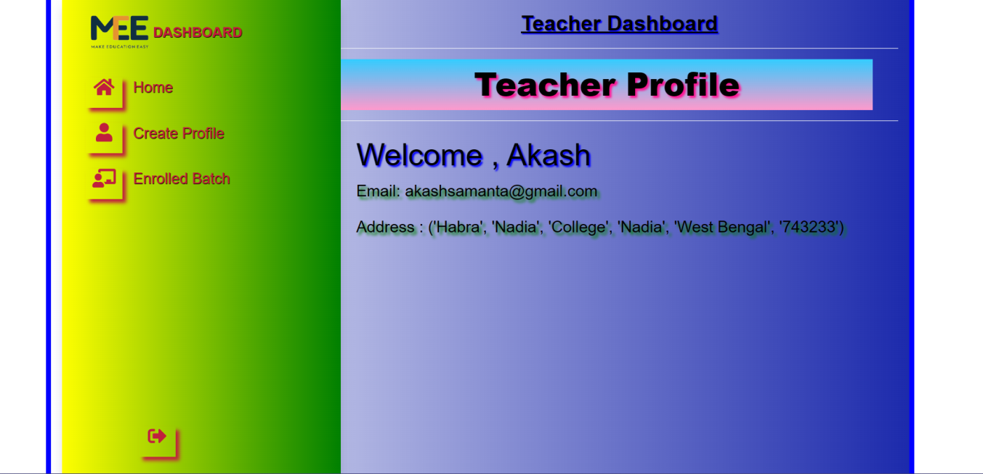
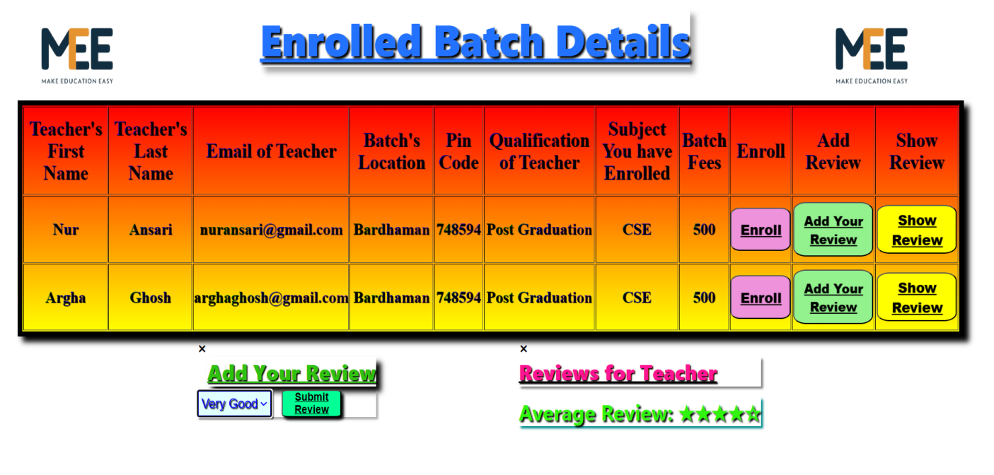
User Interface Page
Student Dashboard
Teacher Dashboard
Enrolled Batch Details page

Slide 10
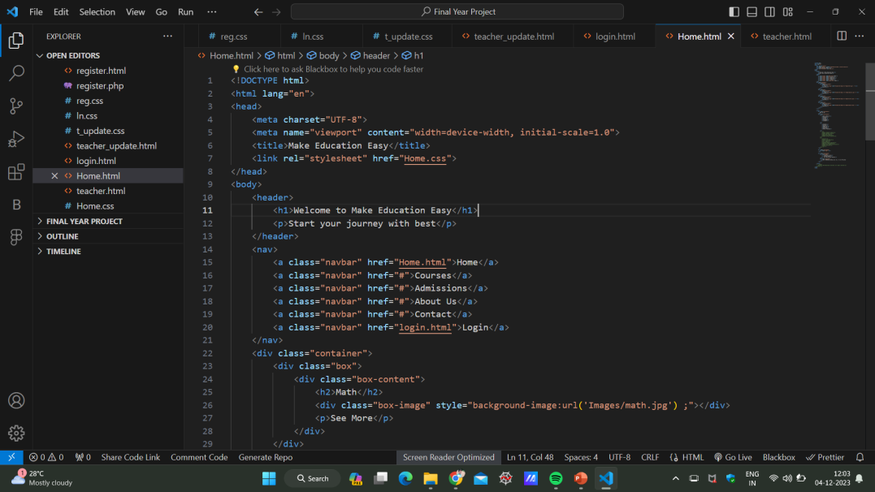
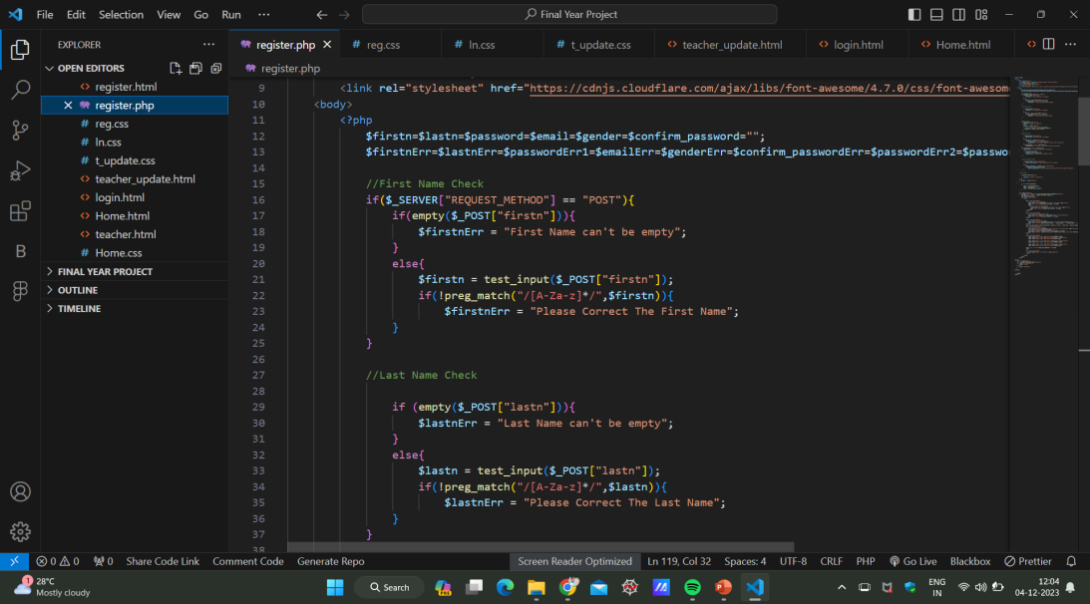
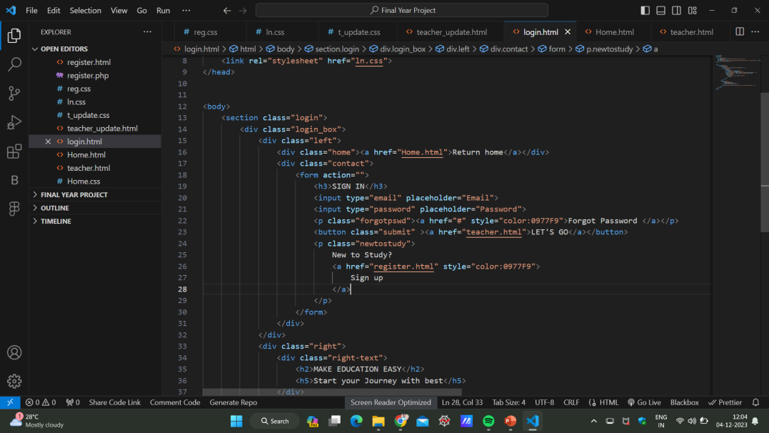
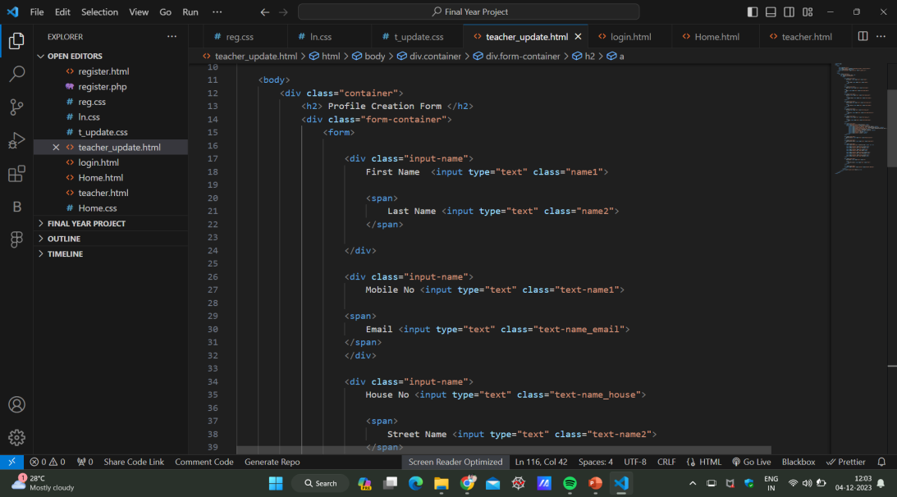
Code

Slide 11
Outcomes
Improved Educational Quality
Convenience and Efficiency
Strengthened Tutor Community
Blended Learning Approach
Data-Driven Insights
Transformation of Education Delivery

Slide 12
Thank
You

